Slide 1
Manifest Destiny
The American Pageant,
Chapter 17

Slide 2
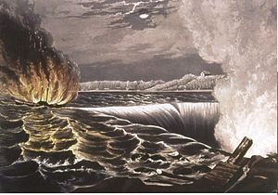
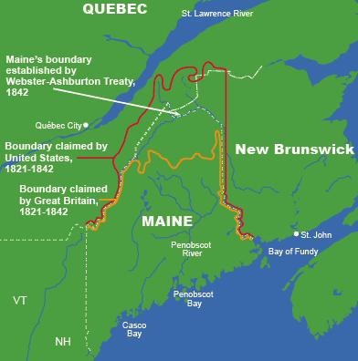
Quick Disputes To Know
England bad mouths USA
Lynching; use of slavery
1837—Caroline Incident
American boat attacked; set on fire by England
Propagandized
Creole Incident
Slave rebolt; Britain offers asylum
Will Caribbean become safe-haven for runaways?
Aroostook War
Disputed territory of Maine—threats of war
Avoid with Webster-Ashburton Treaty
USA retains 7,000 of the 12,000 sq/m dispute

Slide 3
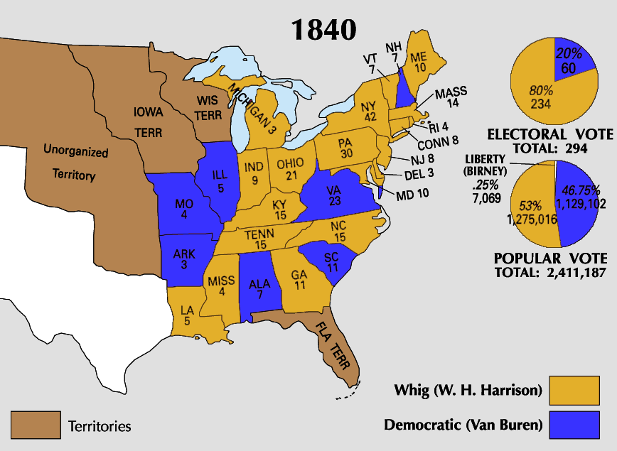
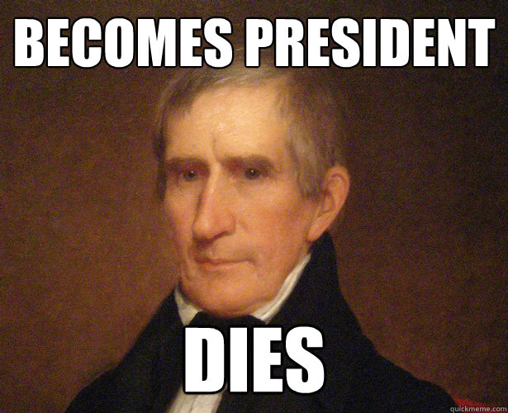
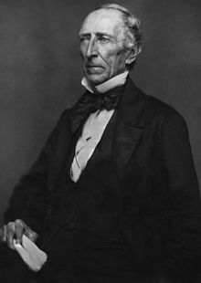
Election of 1840 & The Accidental President
Harrison elected
Tippecanoe and Tyler, too!
Dies 32 days later
VEEP—John Tyler
Former Democrat
Democrat in policy, not personality

Slide 4
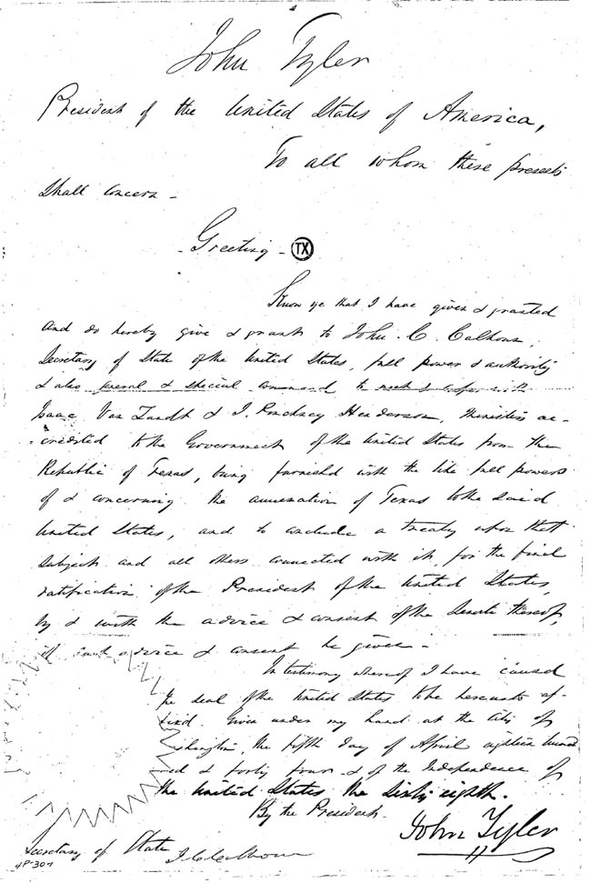
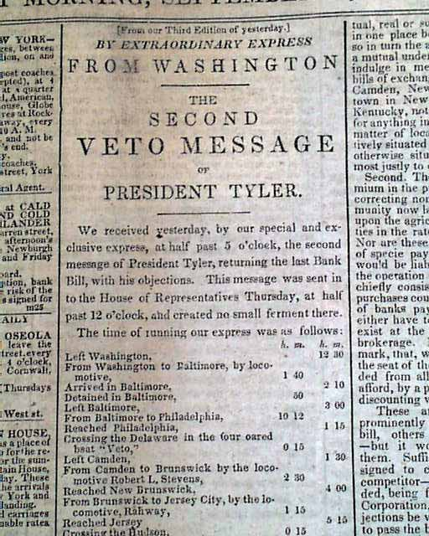
John Tyler As President
A Whig on paper
A Democrat in practice
Blocks Democratic Legislation
Dems led by Henry Clay, Daniel Webster
Vetoes—National Bank Bill; Independent Treasury System
Cabinet resigns; Whigs kick him out of party
Attempts to annex Texas
Shot down in Congress
Slave issue

Slide 5
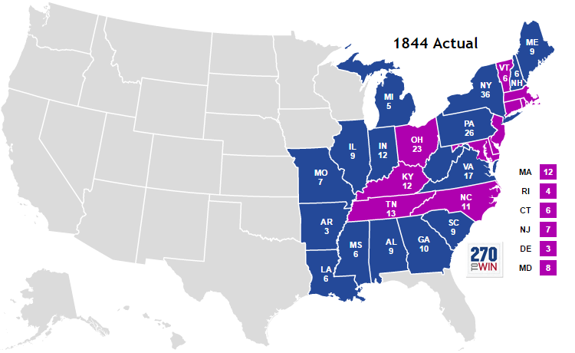
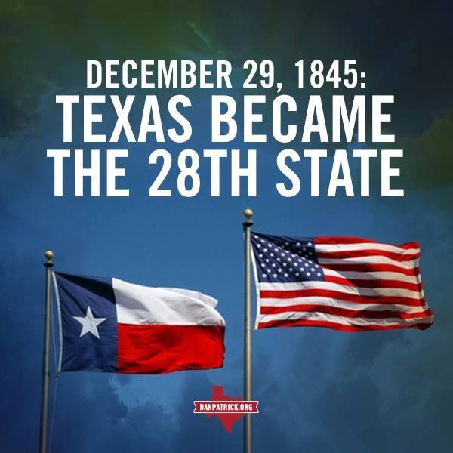
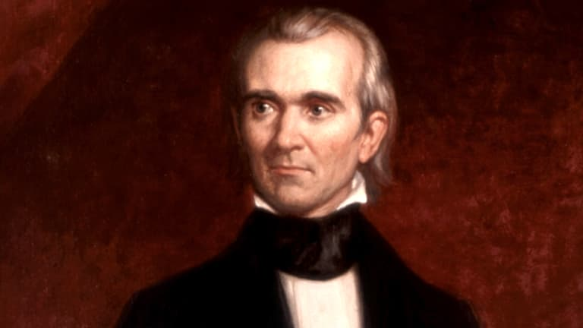
Election of 1844
Election of James K. Polk
“Dark Horse”
Defeats Henry Clay
Wants to annex Texas
Happens in 1845
“Benefits the entire nation”
John Tyler submits treaty to annex Texas before leaving office
Election of 1844 was a “mandate” for Texas
Treaty needs simple majority vote of senate—agreed to
Texas—28th State, 1845

Slide 6
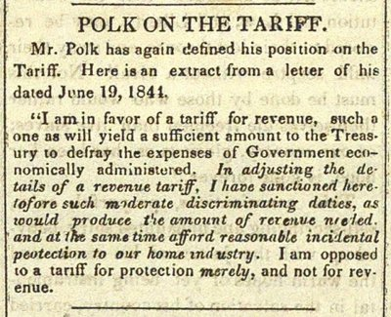
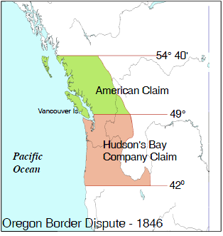
Polk’s Goals
Lower the tariff
Democrat
From the South
Manifest Destiny—expansion
Oregon (54, 40 or Fight)
English Territory?
1818—Agree to peacefully co-occupy with England
England lays more claim to Oregon—
time and distance MATTER
Texas—controversial—slave issue!
California

Slide 7
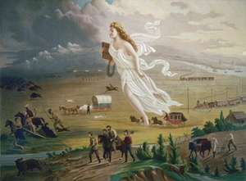
“Manifest Destiny”—John O’Sullivan
America’s destiny (God’s will) to conquer, civilize the continent
Ideas of white superiority
Westward expansion happening from the beginning of our existence
Louisiana Purchase; Missouri Compromise; Indian Policies
Slavery is the key issue!
Oregon Trail
More American settlers than British
Trade (fur)
England aggress to cede land at the 49th parallel
No fight; no war
England gets Vancouver
*American Progress & symbolism

Slide 8
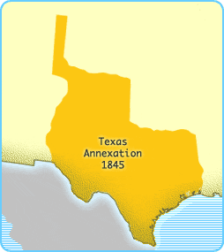
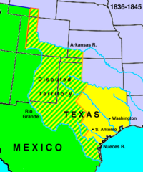
Manifest Destiny—Texas
Texas
Independent in 1836
Mexico sees Texas as a part of Mexico, just “rebels”
President Jackson recognizes the Republic of Texas in 1837
Texas wants annexation—US avoids→ slave issue!
Texas needs military presence to prevent conflict with Mexico
Britain and France? Monroe Doctrine?
Boundary issue—Nueces River, or Rio Grande
US offers to purchase Texas for 25 million
Mexico refuses
Zachary Taylor sent in by Polk to negotiate—Mexico attacks US
Beginning of Mexican-American War (1846-1848)

Slide 9
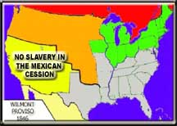
Mexican-American War
Controversial war
War opposed by North—extension of slavery?
Lincoln
Spot Resolution—challenges President to show we were attacked on American soil
Wilmot Proviso
David Wilmot—wants to ban slavery in any territory acquired from Mexico
Passes the House; rejected in Senate
South—upset at North
Way of life under attack

Slide 10
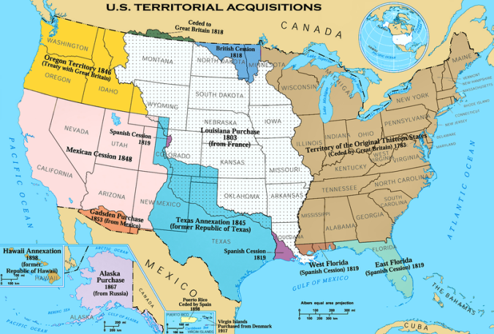
Treaty of Guadalupe-Hidalgo (1848)
Mexico loses most of the major battles
Mexico loses half its territory
Treaty of Guadalupe-Hidalgo (1848)
Mexico cedes CA, NM and rest of Southwest
AZ, UT, NV
Increases US territory by 1/3
Rio Grande established as TX border
Tense relations with USA

